Slide 1
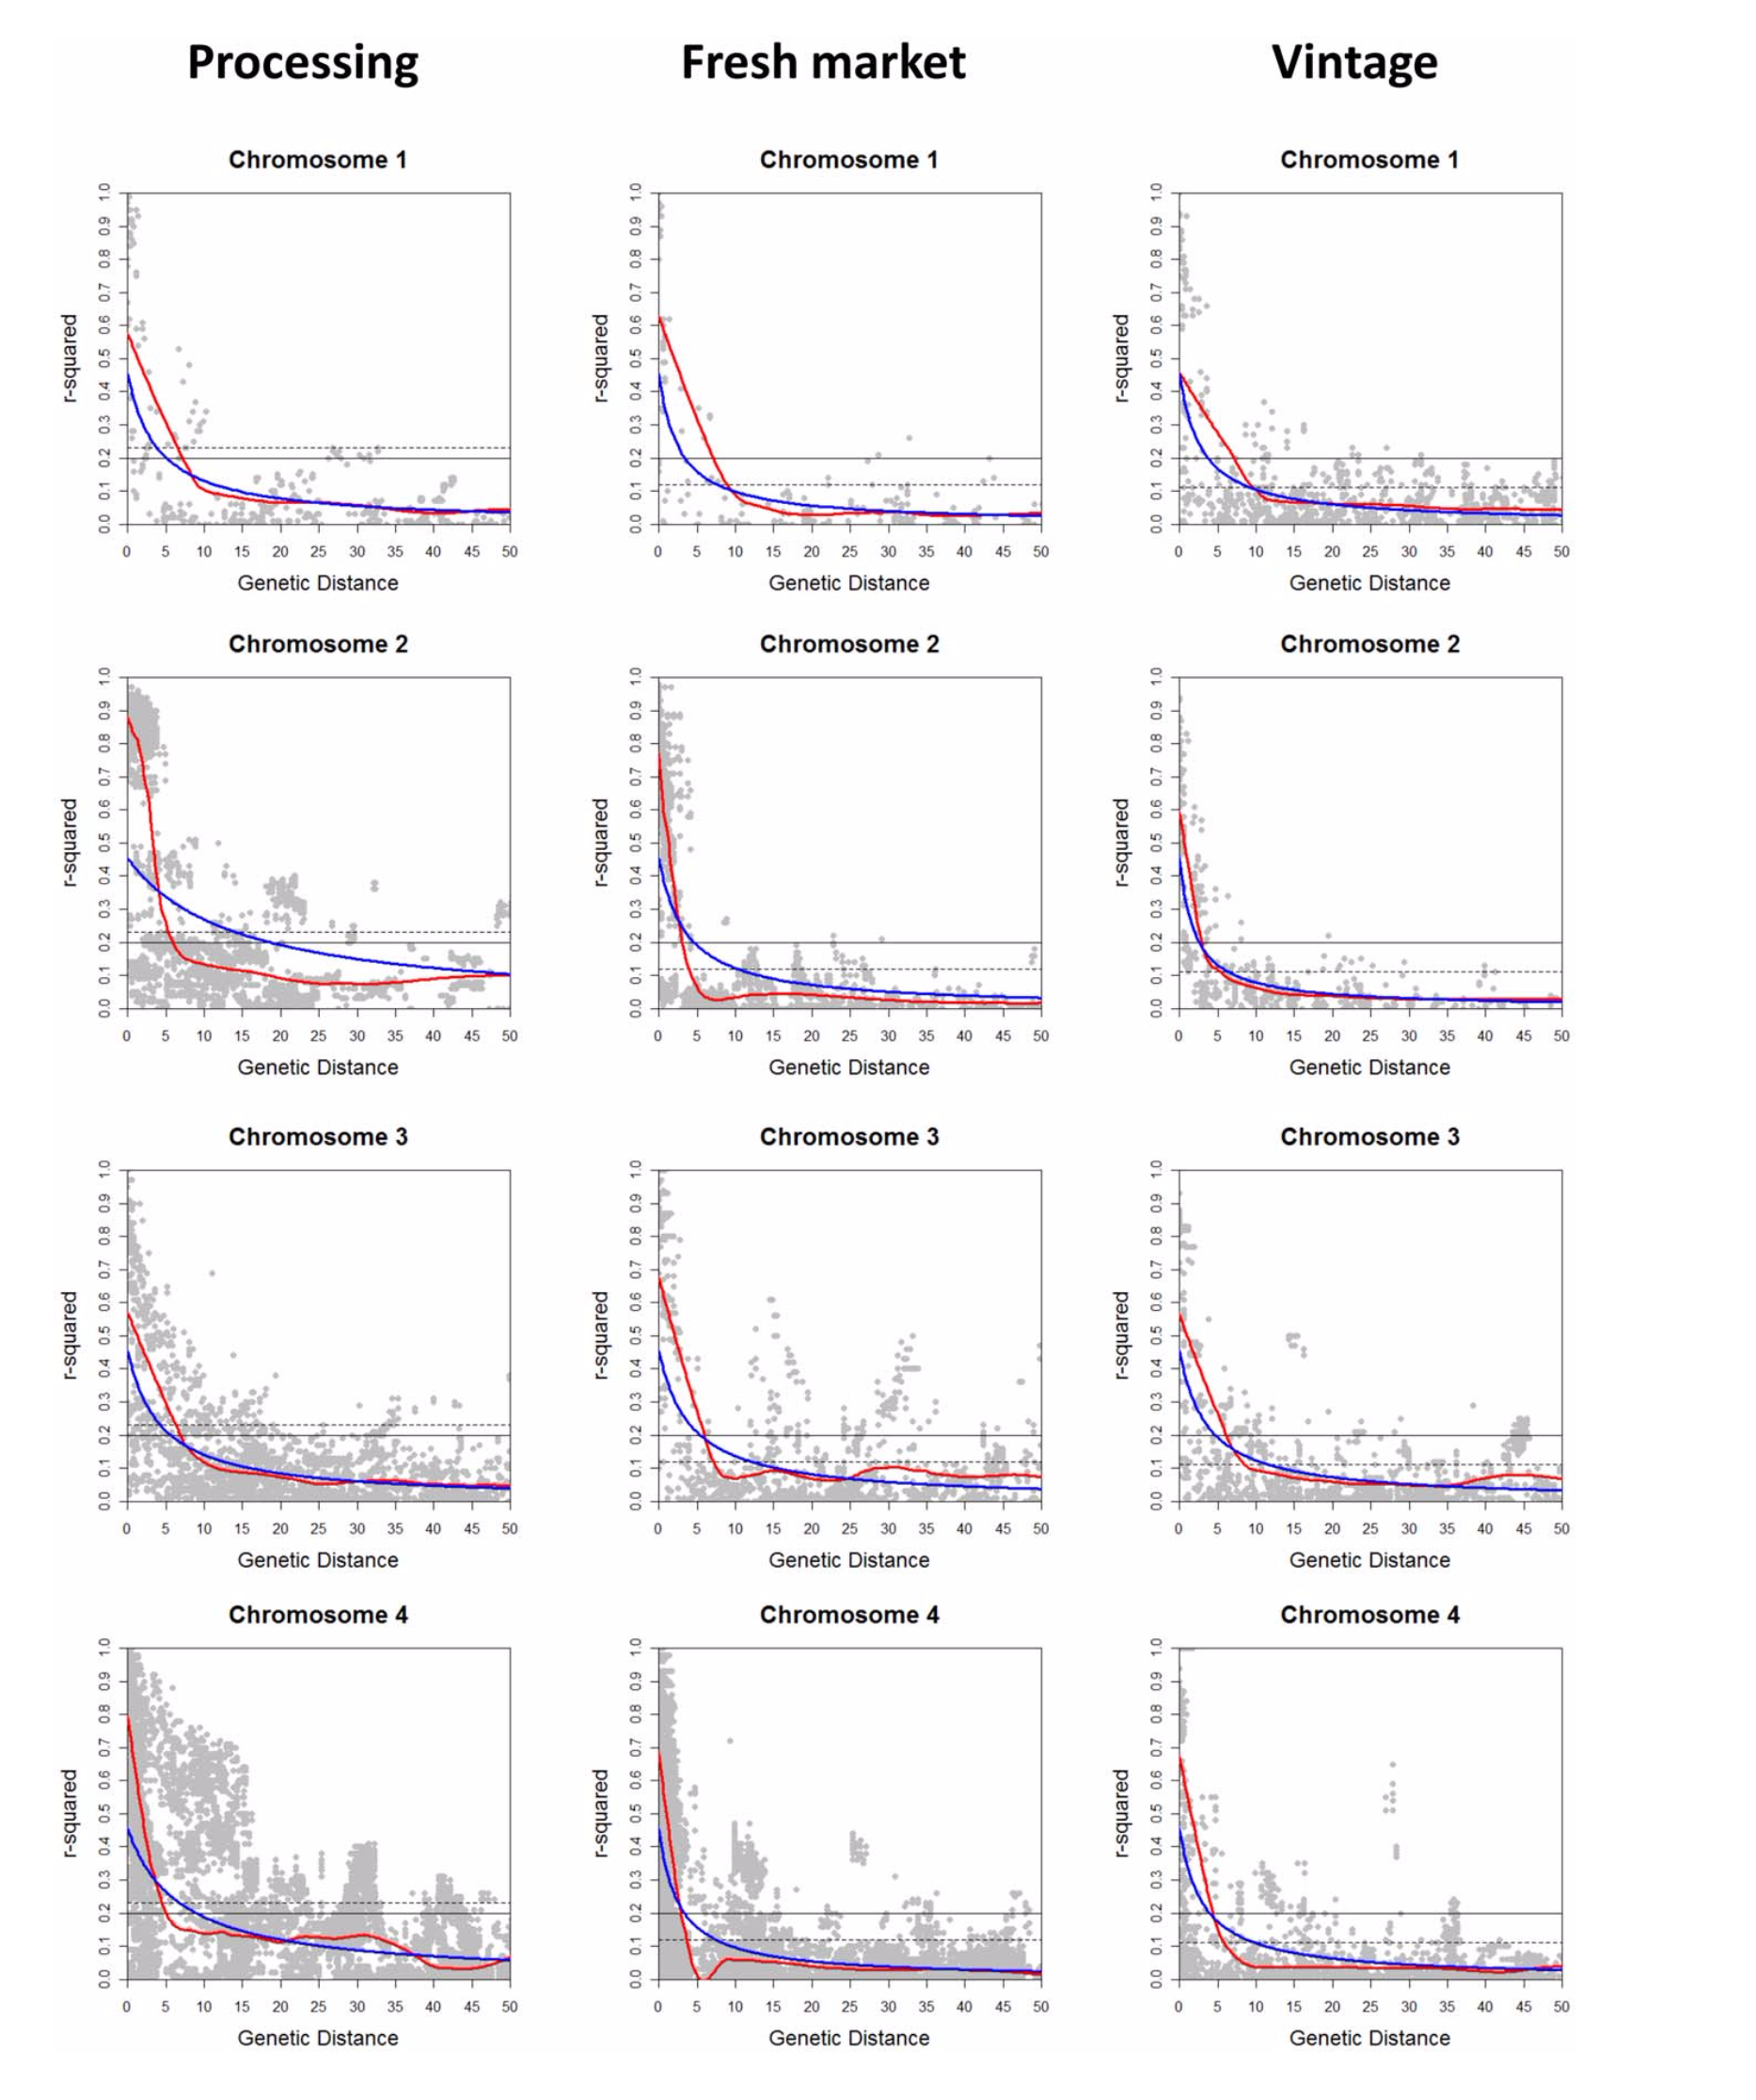
Sim et al. 2012

Slide 2
Sim et al. 2012

Slide 3
Sim et al. 2012

Slide 4
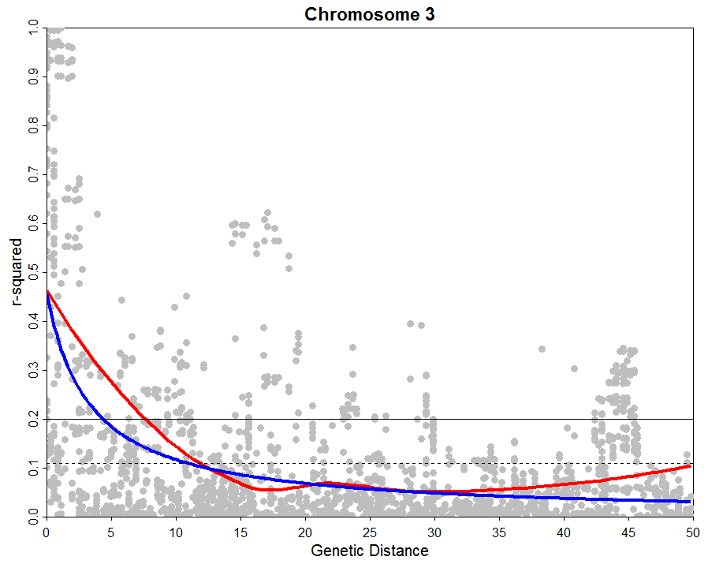
Vintage
Sim et al. 2012

Slide 5
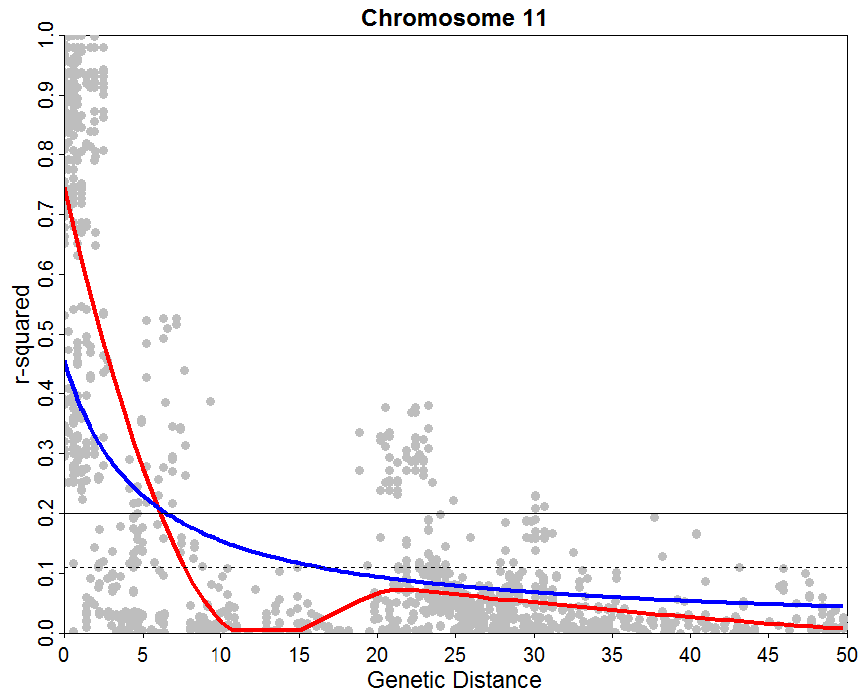
Vintage
Sim et al. 2012

